Slide 1

TEAM - 03
GEN AI
Course Project under the course
Title : Automated Object Removal and Image Restoration Using Stable Diffusion Inpainting.
TEAM DETAILS – TEAM No. 03
Sl. No | Roll No. | Div | SRN | Name
1 | 536 | E | 01FE23BEC271 | SATISH BURUD
2 | 552 | E | 01FE23BEC286 | SAHANA MATHAPATI
3 | 553 | E | 01FE23BEC287 | SURAJ ALAGOUDA
Under the Guidance of Amit T

Slide 2
TEAM - 03
Introduction
Problem Statement : “To develop an AI-powered image inpainting system that automatically removes unwanted objects and generates realistic background reconstruction using Generative AI techniques”.
Problem Definition :
The rapid growth of digital media and online content creation has increased the demand for efficient image editing and restoration techniques. Unwanted objects such as people, vehicles, animals, logos, and other distracting elements often reduce the visual quality and usefulness of images.
Traditional editing approaches are time-consuming and may produce unrealistic reconstruction results.
There is a need for an automated AI-driven solution that can intelligently remove objects and restore the missing image regions.
The proposed system utilizes object segmentation, mask refinement, and Stable Diffusion Inpainting to generate realistic and visually consistent outputs.
The system aims to simplify image editing while improving restoration quality through Generative AI techniques.

Slide 3
TEAM - 03
Objectives
1. To develop an AI-powered image inpainting system for object removal
2. To implement automatic object segmentation and mask generation.
3. To perform mask refinement using OpenCV techniques.
4. To reconstruct missing image regions using Stable Diffusion Inpainting.
5. To generate realistic and visually consistent outputs.
6. To provide a user-friendly web-based interface for image processing.

Slide 4
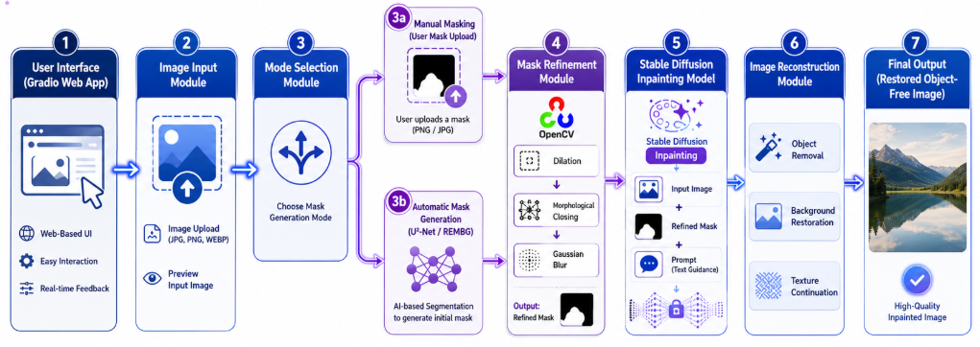
TEAM - 03
System Architecture

Slide 5
TEAM - 03
System Architecture
Image Input Module :
Accepts the input image from the user.
Acts as the entry point of the system.
Supports different image formats such as JPG, PNG, and JPEG.
2. Mode Selection Module :
Provides two methods for object removal.
i. Manual mask upload. ii. Automatic object detection & mask creation
This increases flexibility.
3. U²-Net (REMBG) Segmentation Model :
Detects foreground and objects automatically and generates the masks.
It is a deep learning-based image segmentation model designed to accurately identify and separate foreground objects from the background.
Input image is passed through U²-Net, where the network extracts the object boundaries & foreground regions
Then the foreground object is removed and the Binary mask is generated.

Slide 6
TEAM - 03
4. REMBG Library :
It is a free, open-source Python library used to automatically remove backgrounds from images
Provides easy access to U²-Net segmentation.
Simplifies segmentation implementation.
5. Mask Refinement Module (OpenCV) :
It Improves mask quality before inpainting.
Because the mask may contain noise, small holes and incomplete boundaries.
Dilation : here it expands the mask boundaries.
It also fills the gaps and holes.
It also smoothens the mask edges to remove noise.
6. Stable Diffusion Inpainting Model :
It removes the object and reconstructs the image.
Model use : “runwayml/stable-diffusion-inpainting”
This is an open-source model and specifically trained for the image inpainting.
This produces the realistic reconstructed images.

Slide 7
TEAM - 03
6. Stable Diffusion Inpainting Model (working) :
The model takes inputs as Original image , refined mask , positive prompt and negative prompt.
Here at first the masked region is identified.
Then the stable diffusion analyses the nearby colors , textures , lights and context.
The model then generates new pixels for the missing area.
The generated content is blended with surrounding pixels.
7. Image Reconstruction Module :
Generates the final image.
Here the removed region is reconstructed and surrounding textures are continued naturally.
Colors and lightings are matched.
8. Gradio Web Interface :
This provides the user friendly interface.
It is also easy to deployment and supports the image upload.
Provides Real-time visualization.

Slide 8
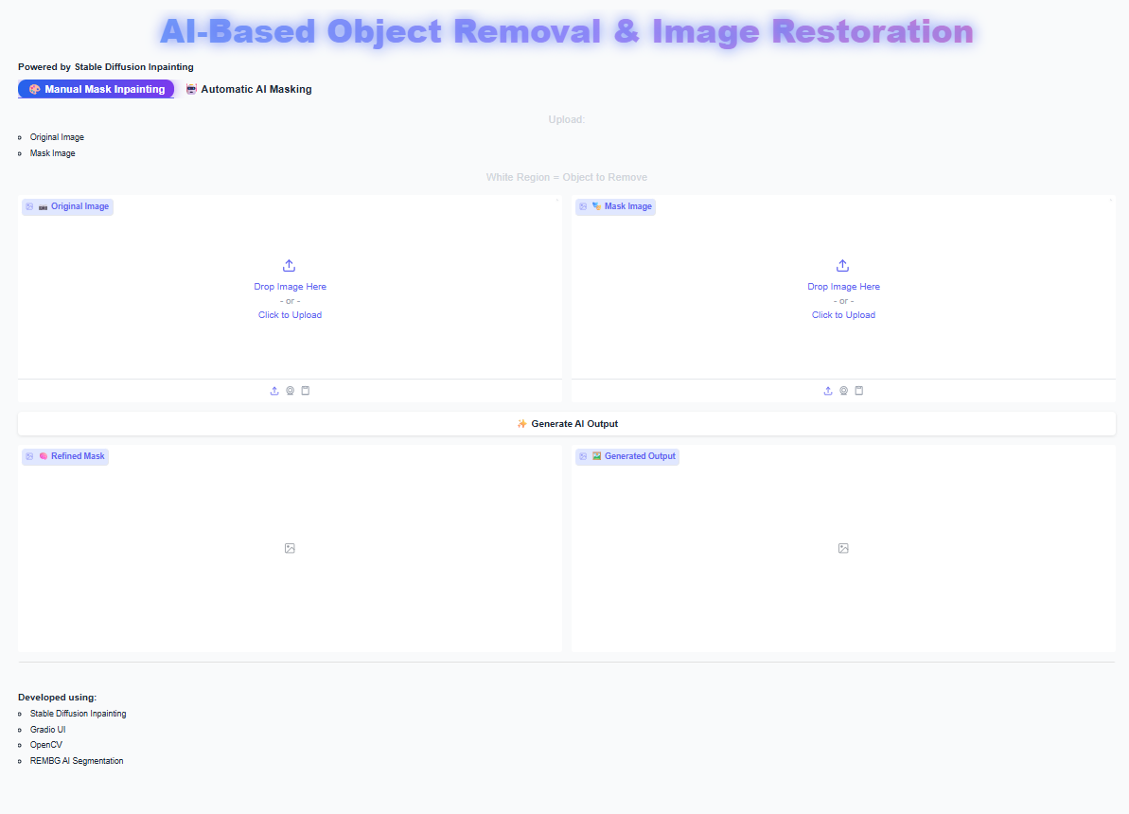
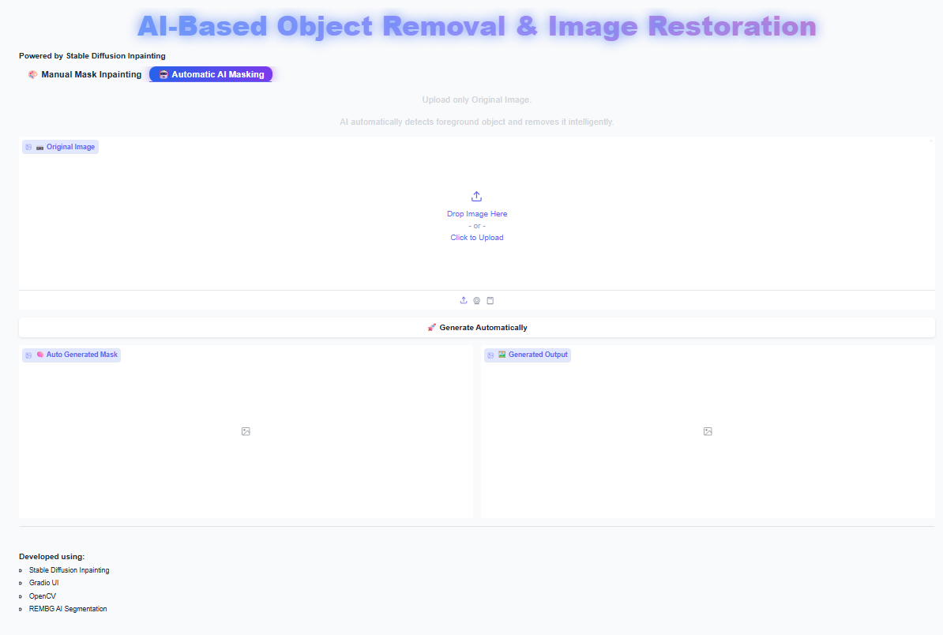
TEAM - 03
Web - Page interface
Manual mode
Automatic mode

Slide 9
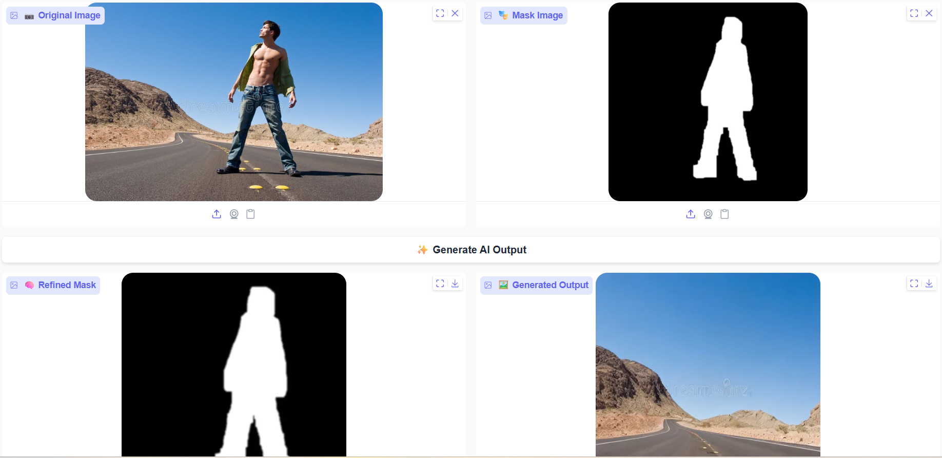
TEAM - 03
Manual Mode output

Slide 10
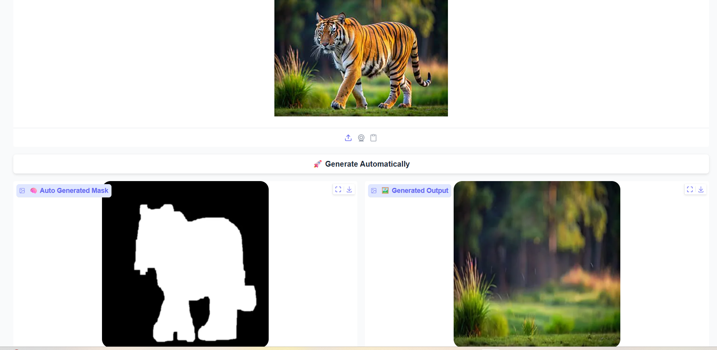
TEAM - 03
Automatic mode output

Slide 11
TEAM - 03
THANK YOU

